Slide 1
SVM
Group Purple
Guillaume Corsini
Taha Sukru Karabacakoglu
Tomasz Kolonko

Slide 2
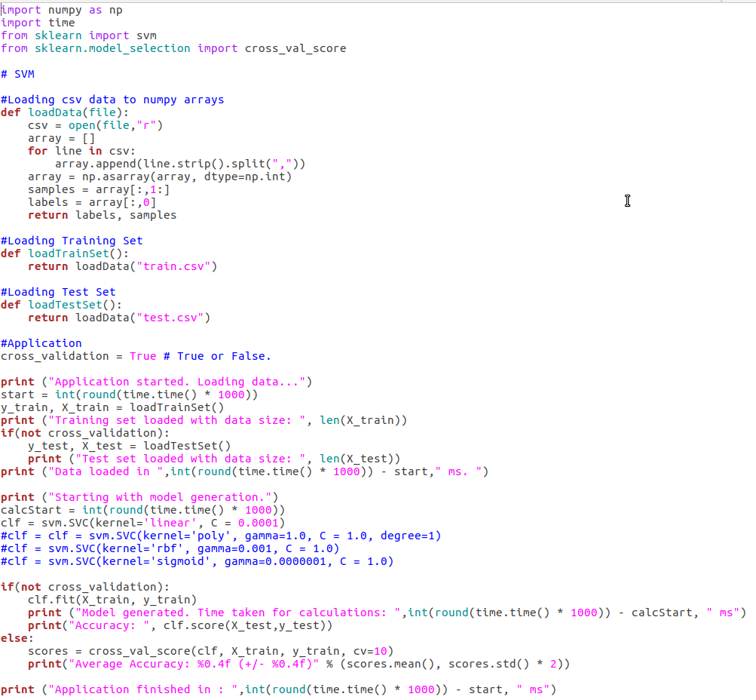
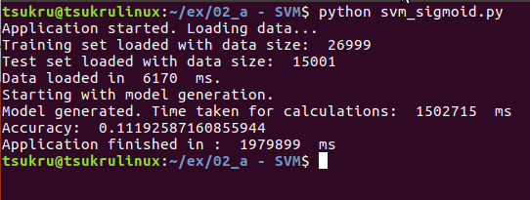
Code
Python 3.6
numpy
sci-kit learn
54 loc

Slide 3
First Results
C = 1.0 , gamma = 1.0
Linear kernel : 0.9081
734,212 ms
Rbf kernel : 0.1119
2,953,819 ms
Polynomial kernel : 0.9081 (degree = 1)
969,006 ms
Sigmoid kernel : 0.1119
1,502,715 ms

Slide 4
Increase in C Value
Linear Kernel
C = 10 , A: 0.9081
846,331 ms
C = 100, A: 0.9081
734,410 ms

Slide 5
Linear Kernel Optimization
C Value | Cross Validation | Test Set
0,001 | 0,9108 | 0,9124
0,0001 | 0,9172 | 0,9227
0,00001 | 0,9281 | 0,9318
0,000001 | 0,938 | 0,9429
0,0000001 | 0,9307 | 0,9345
C Value | Cross Validation | Test Set
0,001 | 2585049 | 242509
0,0001 | 1309508 | 207055
0,00001 | 2034602 | 225293
0,000001 | 2013062 | 235561
0,0000001 | 2786095 | 165584
Best performing C value is C = 0.000001

Slide 6
Polynomial Kernel Optimization
Degree | Cross Validation | Test Set
1 | 0,9084 | 0,9081
2 | 0,9719 | 0,9747
3 | 0,9699 | 0,9726
4 | 0,9617 | 0,9664
5 | 0,9498 | 0,9539
Degree | Cross Validation | Test Set
1 | 3908796 | 825049
2 | 2298065 | 91493
3 | 2445961 | 176622
4 | 2746865 | 131798
5 | 3123996 | 185512
Best performing values are gamma=1.0, C=1.0, degree=2

Slide 7
Other Kernels
Rbf kernel
gamma=0.0000001, C = 1.0, A: 0.9649
457,154 ms
Sigmoid kernel
gamma=0.0000001, C = 1.0, A: 0.9102
788,832 ms

Slide 8
Conclusions
As C value increases the execution time of the program increases as well.
In comparison of execution times, sigmoid and rbf spends similar time. Polynomial kernel performs nearly same with linear kernel and they are faster than sigmoid and rbf.
No observation of overfitting.
Best performing kernel is polynomial with accuracy of 0,9747

Slide 9
Further Improvements
Data normalization
Effect on execution time
Implementing use of arguments

Slide 10
Thanks!
Any questions?

